Slide 1
HS 101: Economics Overview of Macroeconomics
Aditi Chaubal
(Email: aditi@hss.iitb.ac.in)
Reference: Samuelson & Nordhaus (19th edition): Chapter 19

Slide 2
Introduction
Macroeconomics is the study of the behaviour of the economy as a whole. It analyses long-run growth as well as the cyclical movements in total output, unemployment and inflation, money supply, budget deficit, international trade and finance
Examines reasons for growth and decline of nations
Important concepts:
Output: Various useful goods and services which are either consumed or used in further production.
Employment/Unemployment: Measure dependent on the number of people unemployed. A worker is unemployed if he/she is not working and is either waiting to be recalled after a layoff or has actively looked for work in the last 4 weeks (US definition).
India – definition ?
HS101 – Economics (Macroeconomics) - 2019

Slide 3
Introduction
Prices: Money cost of a good, service, or asset. It is measured in monetary units per unit of the good (e.g. Rs. 30 per 1 apple).
Two central themes underlying macroeconomics:
Short-run fluctuations in output, employment, prices (Business cycles)
Long-run trends in output and standard of living (Economic growth)
HS101 – Economics (Macroeconomics) - 2019

Slide 4
Key questions of Macroeconomics
Why do output and employment fall; how can unemployment be reduced?
Recessions, business cycles, droughts
Drivers of output and unemployment
Macroeconomics examines the sources and suggests solutions – nature of solutions
What are the sources of price inflation and how can it be kept under control?
Prices serve as a yardstick to measure economic value, to conduct business
Rapidly increasing prices (inflation) → yardstick loses value → inflation reduces incomes → economic inefficiency
Price stability is a key objective
Macroeconomics examines drivers; and the use of effective monetary and fiscal policy, exchange rate mechanisms and independent central bank to control inflation
HS101 – Economics (Macroeconomics) - 2019

Slide 5
Key questions of Macroeconomics
How can a nation increase its rate of economic growth?
Macroeconomics concerned with long-run prosperity or growth of the country.
Growth of a nation’s productive potential is a key determinant of growth in real wages and living standards.
Ingredients for growth: Role of investment, savings, budget deficits and industrial policies, investment in R&D and human capital
Tradeoffs between goals
Tradeoff between inflation and unemployment: rapid increasing growth of output and drastic fall in unemployment => rising inflation
Tradeoff between growth, investment and consumption: ↑investment in capital and knowledge (possible only if current consumption of food, clothing etc. ↓) => ↑ growth rate
HS101 – Economics (Macroeconomics) - 2019

Slide 6
Objectives of macroeconomics
1. Measuring economic success:
High level and rapid growth of national output
Gross domestic product (GDP): GDP is the measure of the market value of all final goods and services produced in a country during a year.
Nominal GDP vs Real GDP: Nominal GDP is measured in actual market prices. Real GDP is calculated in constant or invariant prices (accounts for inflation).
Potential GDP: Potential GDP represents the maximum sustainable level of output that the economy can produce. An economy operating at potential levels, will have high levels of utilization of the labour and capital stocks.
HS101 – Economics (Macroeconomics) - 2019

Slide 7
Objectives of macroeconomics…
Potential output is determined by the economy’s productive capacity, which depends upon the inputs available (capital, labor, land, etc.) and the economy’s technological efficiency.
Economic downturns are called recessions when a significant decline in total output, income, and employment occur, which usually last more than a few months; and are marked by widespread contractions in many sectors of the economy.
A severe and protracted downturn is called a depression.
HS101 – Economics (Macroeconomics) - 2019
Notes:
Potential output is determined by the economy’s productive capacity, which depends upon the inputs available (capital, labor, land, etc.) and the economy’s technological efficiency.
Potential GDP tends to grow steadily because inputs like labor and capital and the level of technology change quite slowly over time. By contrast, actual GDP is subject to large business-cycle swings if spending patterns change sharply.

Slide 8
Objectives of macroeconomics…
2. High employment, low unemployment
The labor force includes all employed persons and those unemployed individuals who are seeking jobs. It excludes those without work who are not looking for jobs.
The unemployment rate is the percentage of the labor force that is unemployed.
The unemployment rate reflects the state of the business cycle:
When output is falling, the demand for labor falls and the unemployment rate rises.
HS101 – Economics (Macroeconomics) - 2019

Slide 9
Objectives of macroeconomics…
3. Price Stability (Low and stable inflation rate)
Price indices: Indicators of the average price movement over time of a fixed basket of goods and services. The basket of goods and services are compiled after considering whether the changes are to be measured in retail, wholesale or producer prices.
Consumer Price Index (CPI): measures the trend in the average price of goods and services bought by consumers.
Wholesale Price Index (WPI): is a measure of average wholesale price movement for the economy.
Other indices: CPI-Rural, CPI-Urban, CPI-Combined, CPI-Industrial Workers, CPI-Agricultural Labour
HS101 – Economics (Macroeconomics) - 2019
Notes:
An Index is a measure of the change in a group of related variables over two different situations. Group of variables may be the prices of a specified set of commodities, the volumes of production in different sectors of an industry. Two different situations may be two different times, two different places etc. Index numbers are the indicators which reflect changes over a specified period of time in respect of prices of different commodities, industrial production, sales, imports and exports, cost of living, etc. These indicators are important tools for review and management of present economic positions and plan formulation.
Some of the important indices like Wholesale Price Index (WPI), Index of Industrial Production (IIP), Consumer Price Index (CPI), etc. give a fairly good idea as to what is happening in the economy.

Slide 10
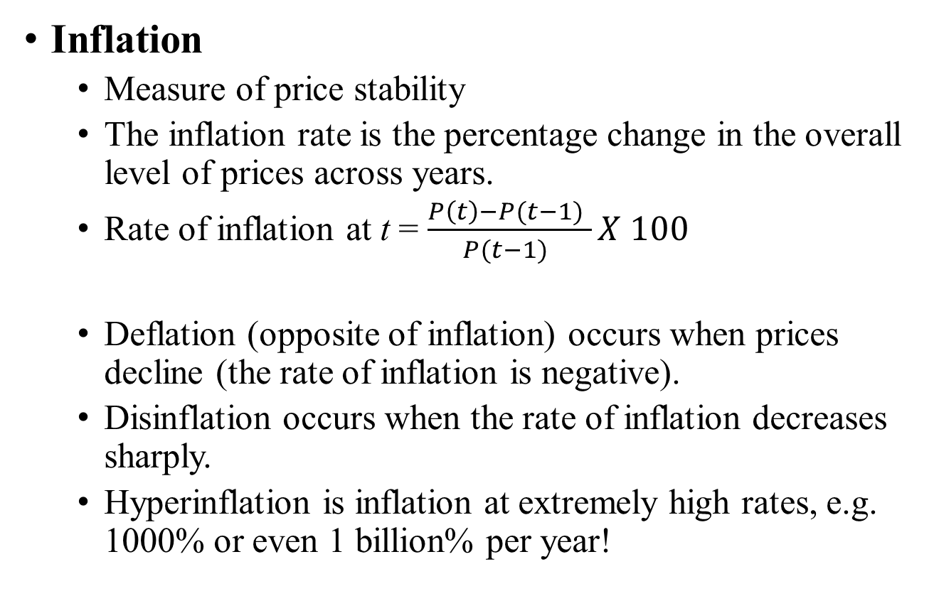
Objectives of macroeconomics…
Inflation
Measure of price stability
The inflation rate is the percentage change in the overall level of prices across years.
Rate of inflation at t = $\frac{P\left(t\right)−P(t−1) }{P(t−1) }X 100$
Deflation (opposite of inflation) occurs when prices decline (the rate of inflation is negative).
Disinflation occurs when the rate of inflation decreases sharply.
Hyperinflation is inflation at extremely high rates, e.g. 1000% or even 1 billion% per year!
HS101 – Economics (Macroeconomics) - 2019
Notes:
Zimbabwe 897*10^20% in (Nov 2007 to Nov 2008) [79.6 billion % (Oct 2008 to Nov 2008)

Slide 11
Objectives of macroeconomics…
Importance of price stability: A smooth functioning market system requires that prices accurately convey information about relative scarcities.
Costs of high inflation: Taxes become highly variable, the real values of people’s pensions are eroded, and people spend real resources to avoid depreciating currency.
Cost of declining prices (deflation): Economic stagnation, periods of high unemployment, increase in real debt burden.
HS101 – Economics (Macroeconomics) - 2019
Notes:
Zimbabwe 897*10^20% in (Nov 2007 to Nov 2008) [79.6 billion % (Oct 2008 to Nov 2008)

Slide 12
Tools and Instruments of Macroeconomic Policy
Policy instrument: is an economic variable under the control of government which can affect (in order to attain) the macroeconomic goals.
Fiscal policy: A government’s program/policy used to affect and achieve long-term economic growth through its impact on national savings and investment; it is also used to stimulate spending in deep recessions.
Instruments: (i) the purchase of goods and services and expenditure on transfer payments (Government expenditure) and (ii) the amount and type of taxes (Taxation) in order to achieve the macroeconomic goals.
HS101 – Economics (Macroeconomics) - 2019

Slide 13
Tools and Instruments of Macroeconomic Policy
Government expenditure → (i) Government purchases, (ii) Government transfer payments
Government purchases = spending by the government on goods and services, infrastructure, defence and salaries
Transfer payments = payments made to targeted groups such as elderly, unemployed etc.
Government expenditure influences the relative size of collective spending and private consumption.
Taxation subtracts from incomes, reduces private spending, and affects private saving while affecting investment and potential output.
HS101 – Economics (Macroeconomics) - 2019

Slide 14
Tools and Instruments of Macroeconomic Policy
Monetary policy: A policy (usually implemented by the central bank) which impacts the money supply (and thus, the credit, interest rates and output) in the economy to attain the macroeconomic goals.
Monetary policy affects credit conditions, including asset prices such as stock and bond prices and exchange rates (exchange rates are a central part of the policy in open economies).
Changes in interest rates, along with other financial conditions, affect spending in sectors such as business investment, housing, and foreign trade.
HS101 – Economics (Macroeconomics) - 2019

Slide 15
Tools and Instruments of Macroeconomic Policy
Monetary policy has an important effect on both actual GDP and potential GDP.
Instruments: Money supply, open market operations, interest rates
Interactions between money supply, interest rates, output, inflation, external sector in the long- and short-run
HS101 – Economics (Macroeconomics) - 2019

Slide 16
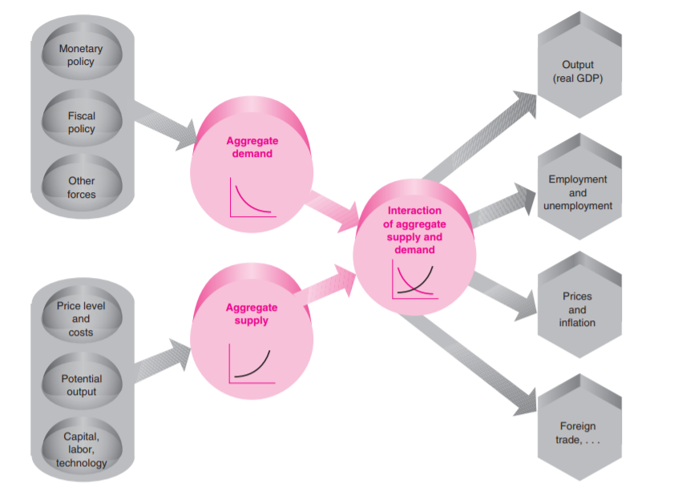
Aggregate Supply and Aggregate Demand determine major macroeconomic variables (Ref: Samuelson & Nordhaus: Economics, 19th Ed.)

Slide 17
Aggregate Demand
Aggregate demand (AD): Aggregate demand consists of the total spending in an economy by households, businesses, governments, and foreigners. It represents the total output that would be willingly bought at each price level, given the monetary and fiscal policies and other factors affecting demand.
Formally: Total planned or desired spending in the economy during a given period. It is determined by the aggregate price level, and influenced by domestic investment, net exports, government spending, consumption function and money supply.
AD curve: graphs the relation between the quantity of goods and services that people are willing to buy at the aggregate price level, ceteris paribus; with the dynamics driven by government spending, consumption function and money supply.
HS101 – Economics (Macroeconomics) - 2019

Slide 18
Aggregate Supply
Aggregate Supply (AS): is the quantity of output businesses would willingly produce and sell in a given period (at given prices, costs and market conditions).
Formally: Total value of goods and services that firms would willingly produce in a given time period. It is a function of available inputs, technology and price level.
AS curve: graphs the relation between the output which firms would willingly supply and the aggregate price level, ceteris paribus. The curve tends to be vertical at potential output but may be relatively flat in the short run.
HS101 – Economics (Macroeconomics) - 2019

Slide 19
AD and AS curves vs. (Microeconomic) Market demand and supply curves
Microeconomic demand (DD) and supply (SS) curves show the quantities and prices of individual commodities, with factors such as national income and prices of other commodities held as a given. | AD and AS curves represent the determination of total output and price level of an economy, with factors such as money supply, fiscal stance, and capital stock held constant.
HS101 – Economics (Macroeconomics) - 2019

Slide 20
AD and AS curves vs. (Microeconomic) Market demand and supply curves…
DD and SS help represent the impact of a policy measure or shock (say, increase in tax on a commodity) on the demand and supply of that commodity or related commodities. | AD and AS help represent the impact of a policy measure or shock (say, increase in taxes) on national output and aggregate price levels.
HS101 – Economics (Macroeconomics) - 2019

Slide 21
Other important concepts – Open economy
Macroeconomic equilibrium: combination of overall price and quantity at which neither buyers nor sellers wish to change their purchases, sales or price levels.
Supply shock: sudden change in production costs or productivity which has a large unexpected impact on AS. The supply shock also results in unexpected changes in the real GNP and price level.
Globalization: Increasing interconnectedness of countries in the world economy through trade (current account balances) and finance.
Trade policies: Tariffs, quotas and regulations which can restrict or encourage imports and exports. Severe restrictions on international trade can cause major economic dislocations, inflation or recessions.
International financial management: Foreign exchange rate systems are an integral part of monetary policy.
Role of economic policy
HS101 – Economics (Macroeconomics) - 2019

Slide 22
Ref: Reserve Bank of India Online Database on the Indian Economy (RBI-DBIE)

Slide 23
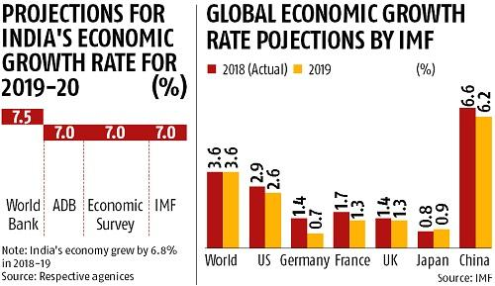
GDP projections for India
OECD is the latest (and most pessimistic) to cut India’s GDP forecast for 2019-20 to 5.9% (September 20, 2019).
HS101 – Economics (Macroeconomics) - 2019

Slide 24
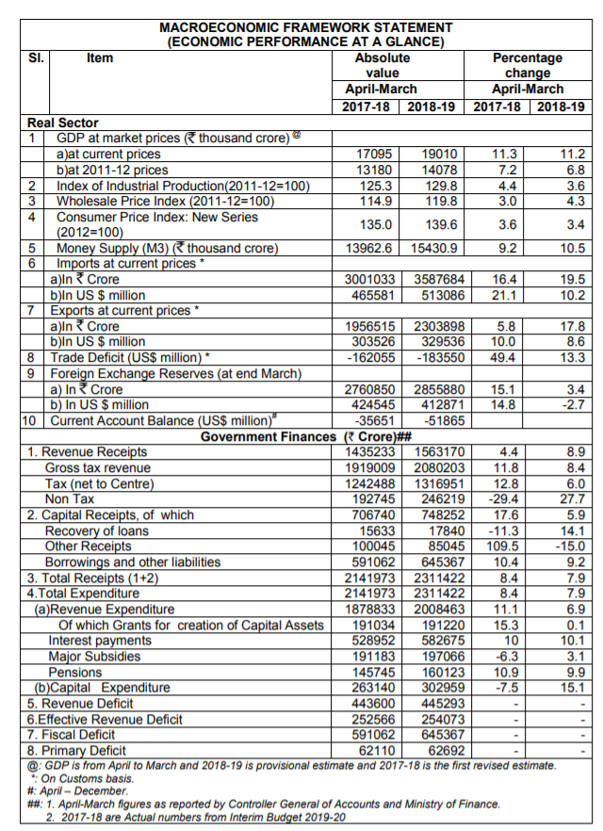
Ref: Union Budget 2019-20: The Macroeconomic Framework Statement

Slide 25
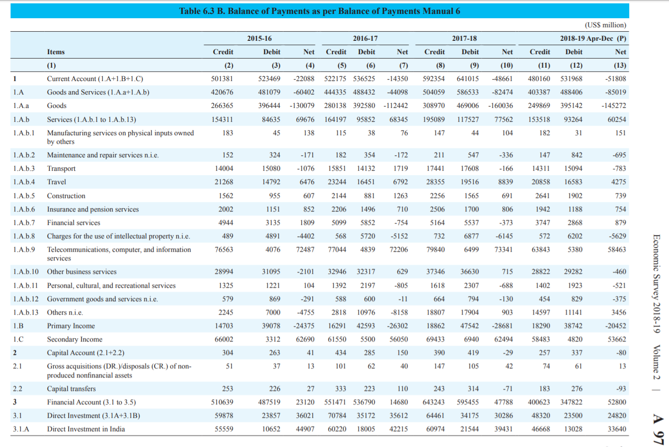
Ref: Economic Survey 2018-19: Statistical Appendix

Slide 26
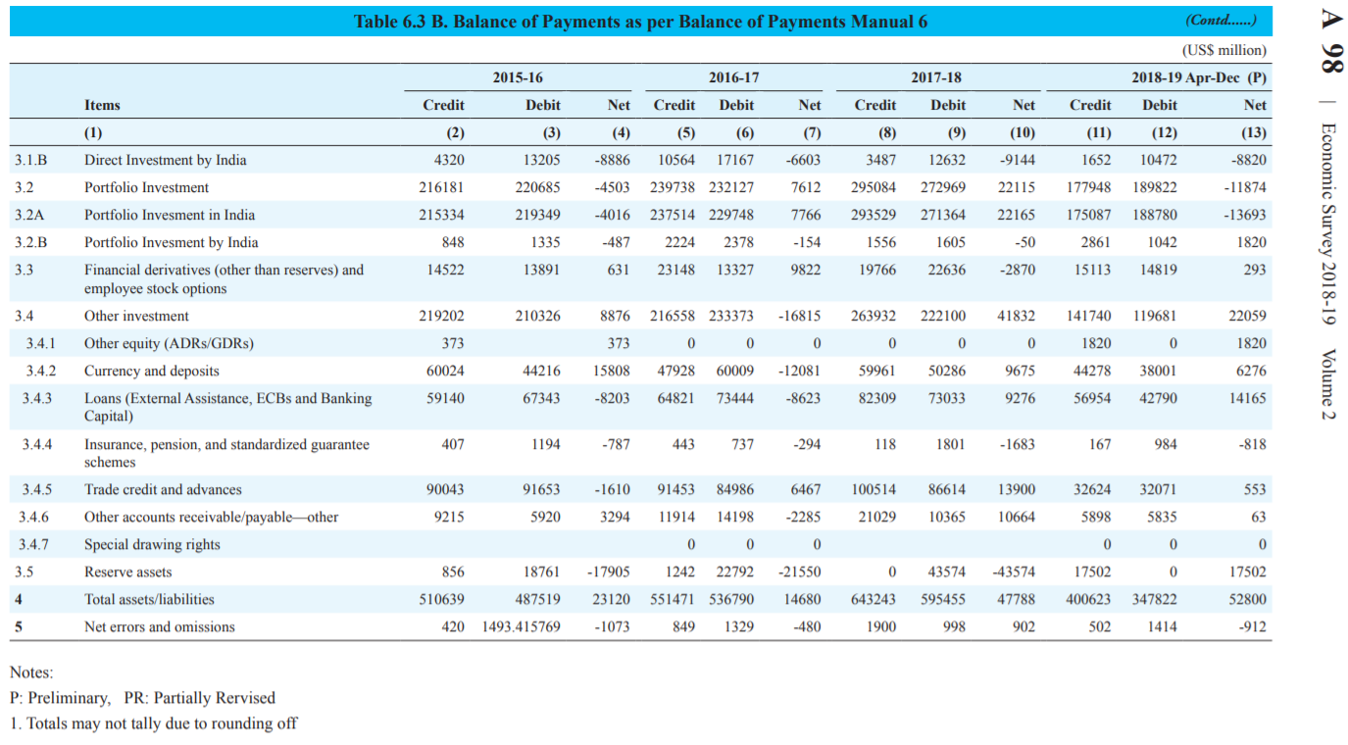
Ref: Economic Survey 2018-19: Statistical Appendix

Slide 27
Thank you

